Slide 1
Knapsack Problem

Slide 2
Knapsack problem
A 1998 study of the Stony Brook University Algorithm Repository showed that, out of 75 algorithmic problems, the knapsack problem was the 18th most popular and the 4th most needed after kd-trees, suffix trees, and the bin packing problem

Slide 3
Knapsack Problem
Given a set of items, each with a mass and a value, determine the number of each item to include in a collection so that the total weight is less than or equal to a given limit and the total value is as large as possible.
It derives its name from the problem faced by someone who is constrained by a fixed-size knapsack and must fill it with the most valuable items.
Notes:
1. Items are indivisible: you either take an item or not. Solved with dynamic programming
2. Items are divisible: you can take any fraction of an item. Solved with a greedy algorithm

Slide 4
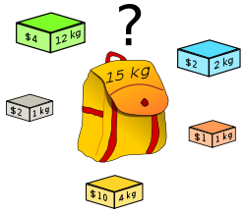
Knapsack Problem
which boxes should be chosen to maximize the amount of money while still keeping the overall weight under or equal to 15 kg?
Answer: 3 yellow boxes and 3 grey boxes
Notes:
1. Items are indivisible: you either take an item or not. Solved with dynamic programming
2. Items are divisible: you can take any fraction of an item. Solved with a greedy algorithm

Slide 5
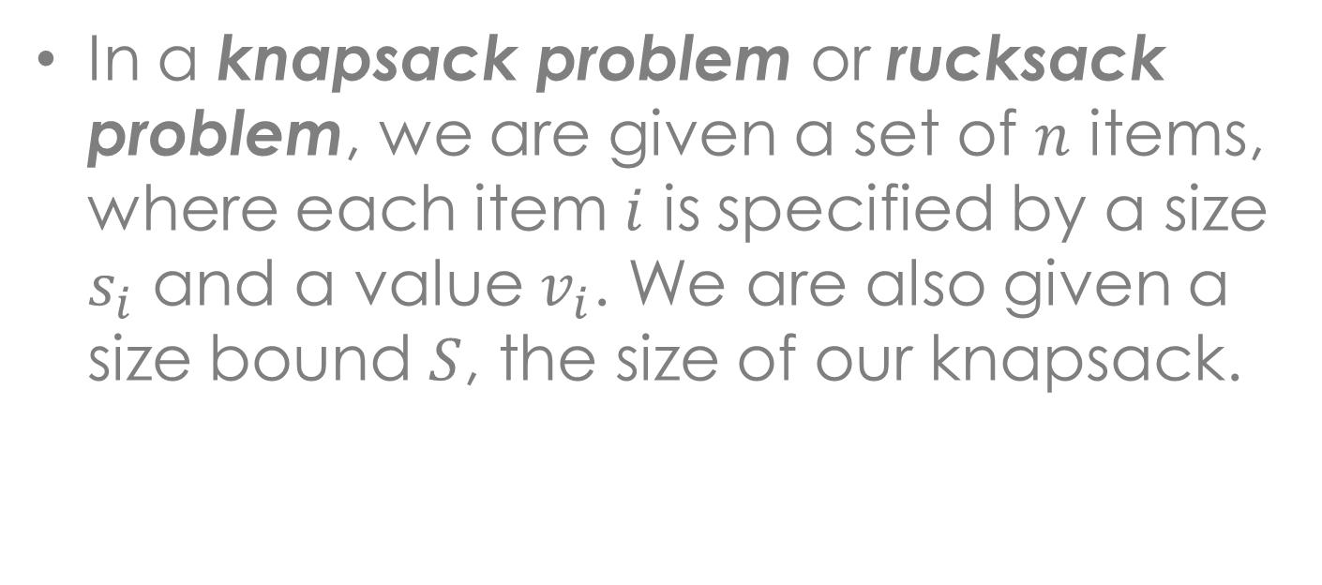
Knapsack Problem
Item # | Size | Value
1 | 1 | 8
2 | 3 | 6
3 | 5 | 5

Slide 6
Knapsack Problem
There are two versions of the problem:
0-1 Knapsack Problem
Fractional Knapsack Problem
Bounded Knapsack Problem
Unbounded Knapsack Problem
Notes:
1. Items are indivisible: you either take an item or not. Solved with dynamic programming
2. Items are divisible: you can take any fraction of an item. Solved with a greedy algorithm

Slide 7
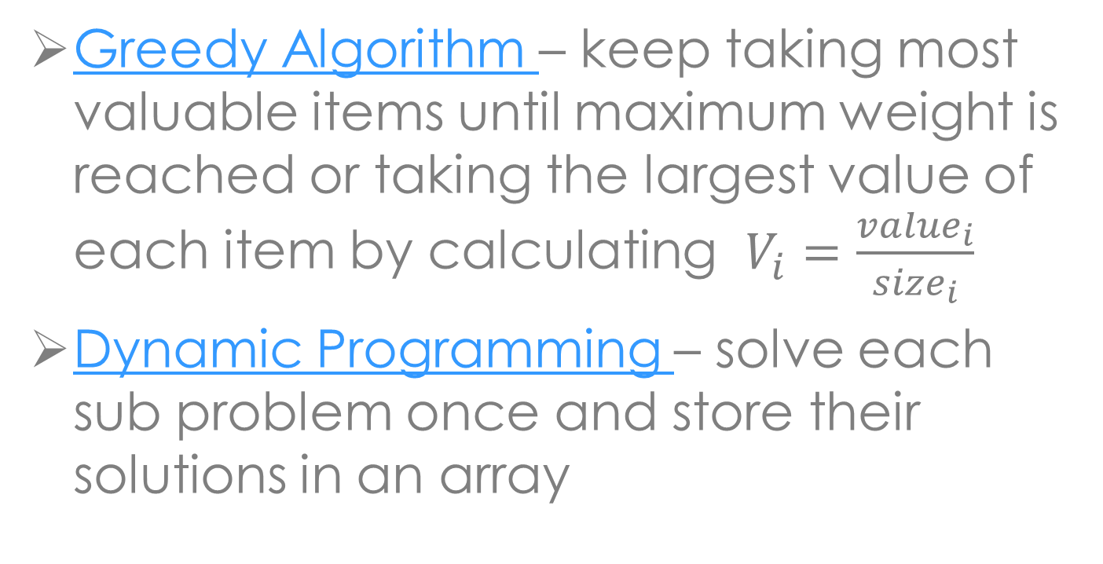
Solutions to Knapsack Problems

Slide 8
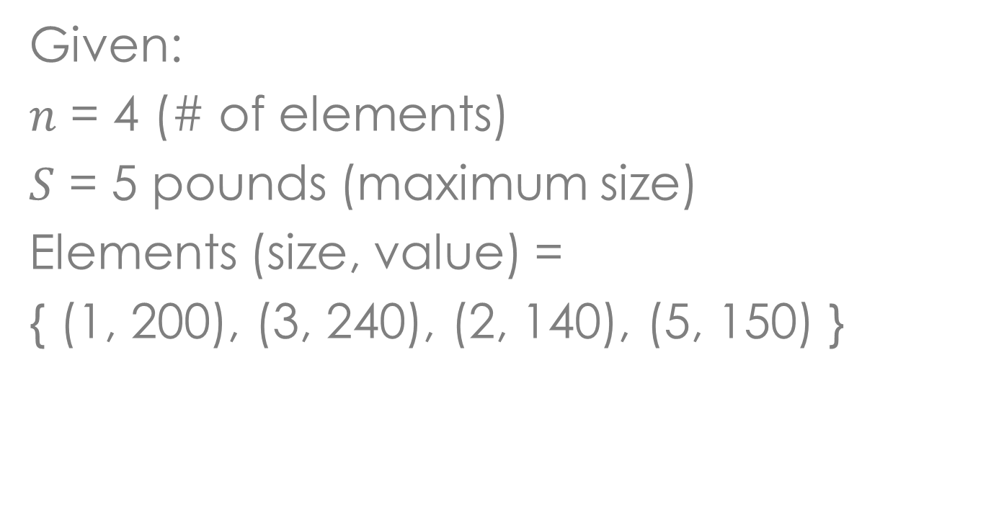
Example

Slide 9
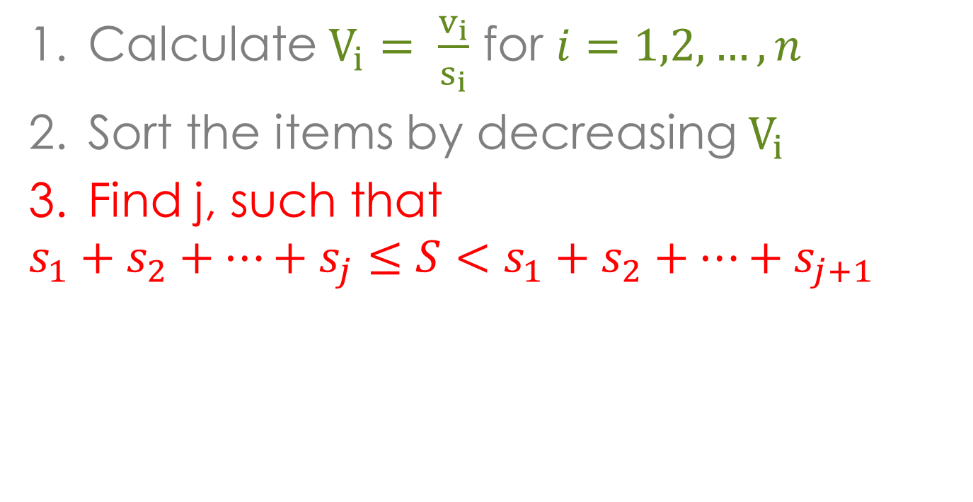
Greedy Algorithm
Notes:
Legend:
Red – wala pud ko kasabot

Slide 10
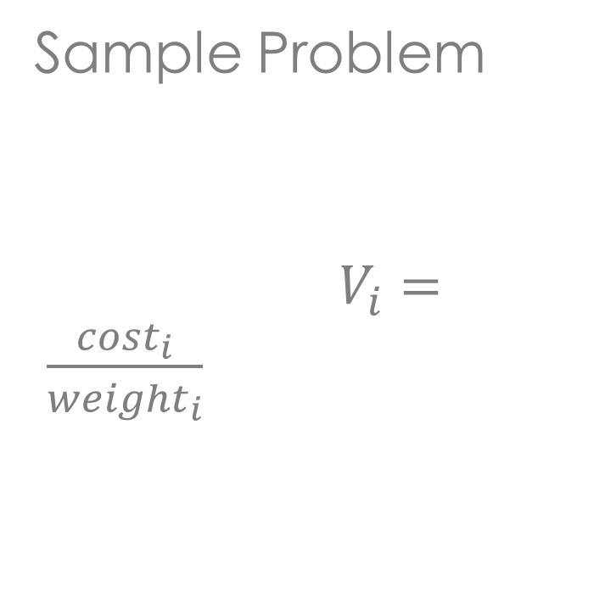
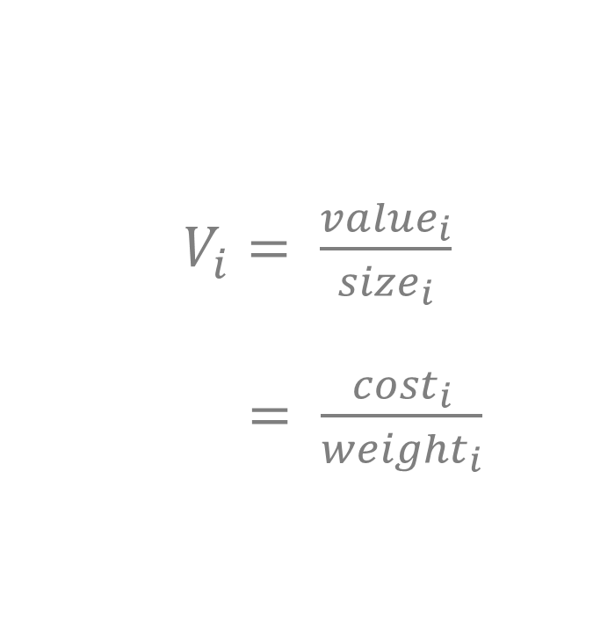
Greedy Algorithm
 | A | B | C | D
cost | 200 | 240 | 140 | 150
weight | 1 | 3 | 2 | 5
value | 200 | 80 | 70 | 30
Notes:
Solution is
1 pds A
3 pds B
1 pd C

Slide 11
Greedy Algorithm
The optimal solution to the fractional knapsack
Not an optimal solution to the 0-1 knapsack

Slide 12
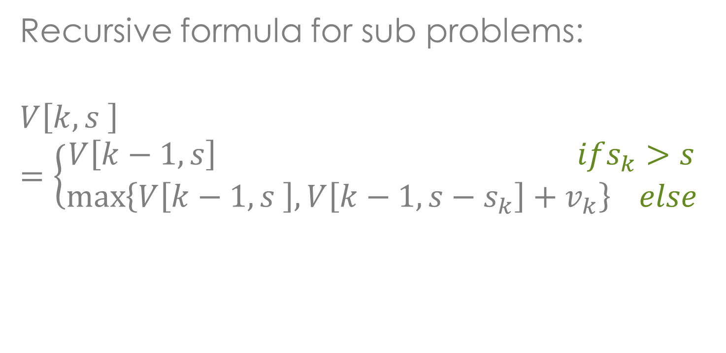
Dynamic Programming

Slide 13
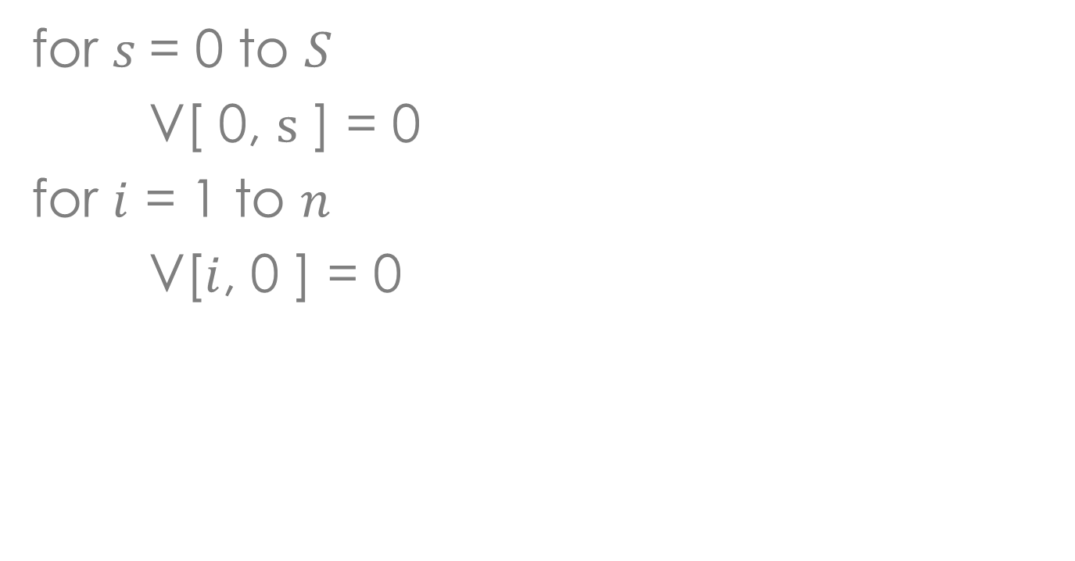
Dynamic Programming

Slide 14
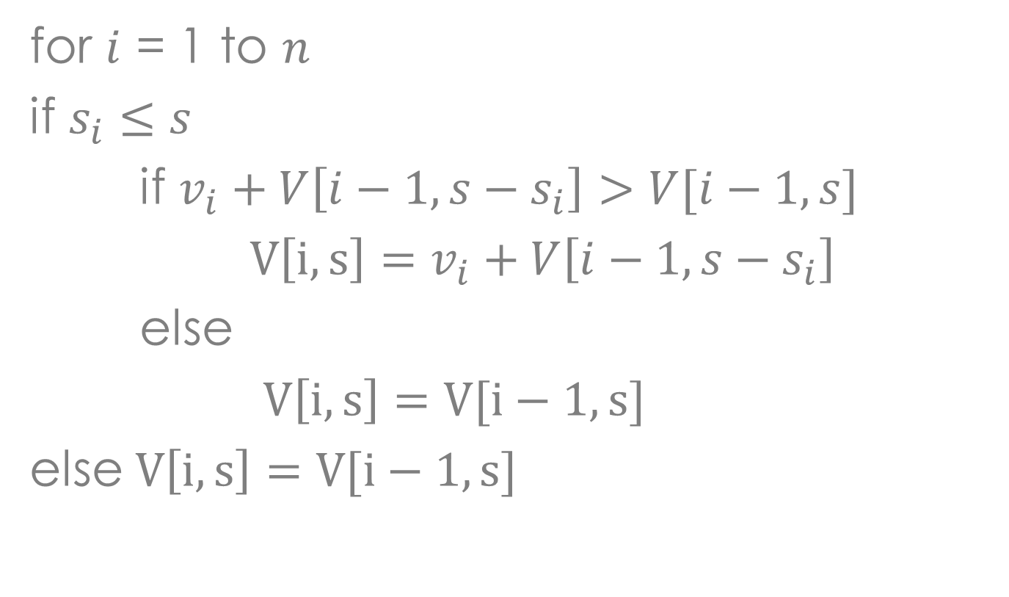
Dynamic Programming

Slide 15
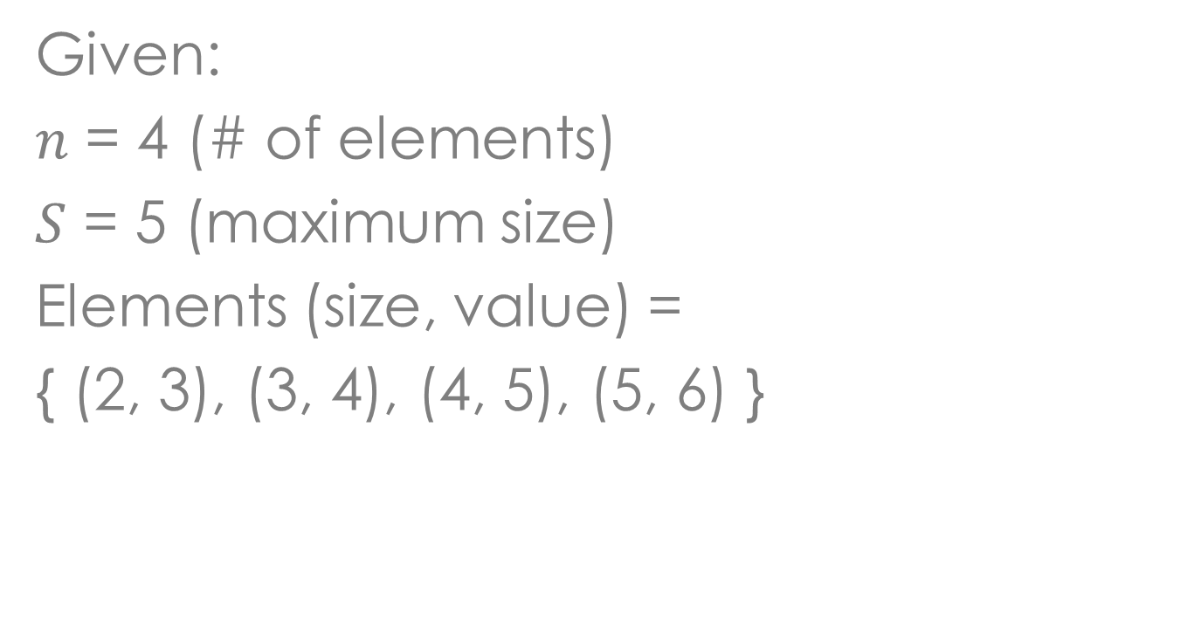
Example

Slide 16
Example
i\s | 0 | 1 | 2 | 3 | 4 | 5
0
1
2
3
4

Slide 17
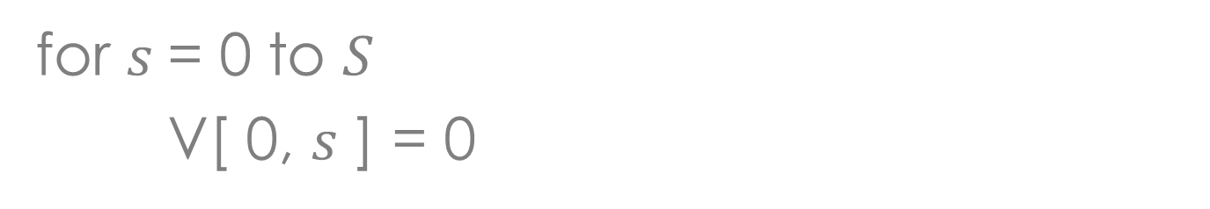
Example
i\s | 0 | 1 | 2 | 3 | 4 | 5
0 | 0 | 0 | 0 | 0 | 0 | 0
1
2
3
4

Slide 18
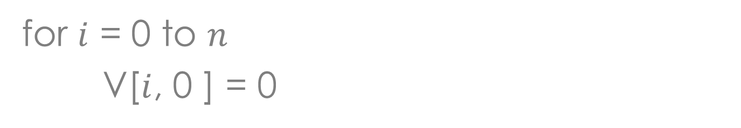
Example
i\s | 0 | 1 | 2 | 3 | 4 | 5
0 | 0 | 0 | 0 | 0 | 0 | 0
1 | 0
2 | 0
3 | 0
4 | 0

Slide 19
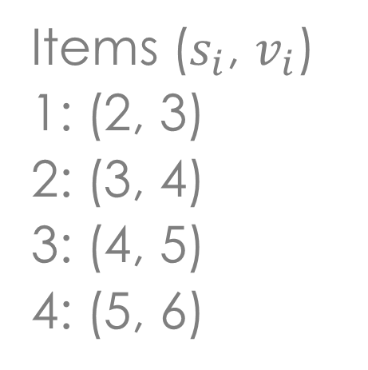
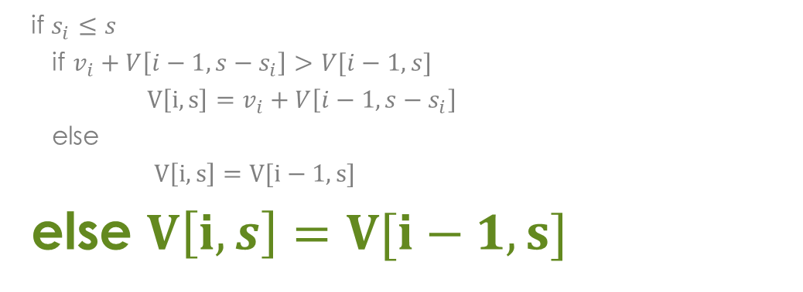
Example
i\s | 0 | 1 | 2 | 3 | 4 | 5
0 | 0 | 0 | 0 | 0 | 0 | 0
1 | 0 | 0
2 | 0
3 | 0
4 | 0
Notes:
i = 1
v_{i} = 3
s_{i} = 2
s = 1
s - s_{i} = -1

Slide 20
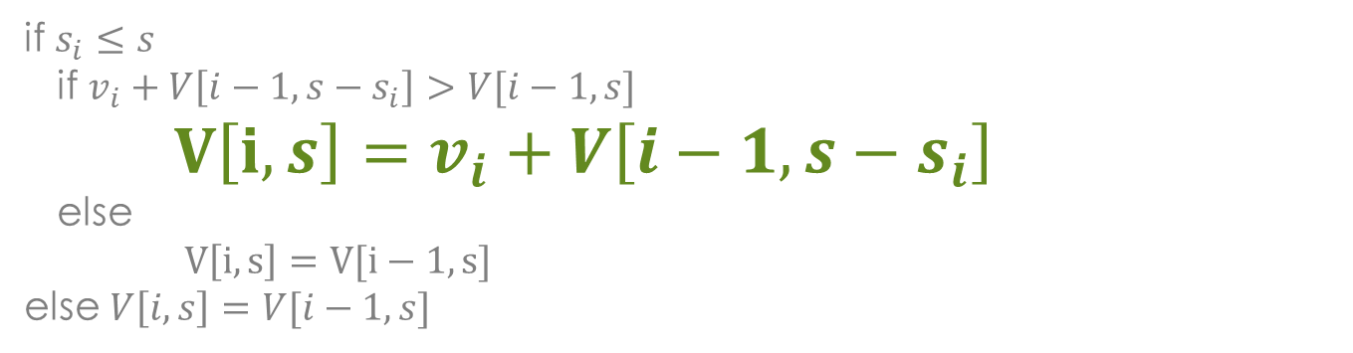
Example
i\s | 0 | 1 | 2 | 3 | 4 | 5
0 | 0 | 0 | 0 | 0 | 0 | 0
1 | 0 | 0 | 3
2 | 0
3 | 0
4 | 0
Notes:
i = 1
v_{i} = 3
s_{i} = 2
s = 2
s - s_{i} = 0

Slide 21
Example
i\s | 0 | 1 | 2 | 3 | 4 | 5
0 | 0 | 0 | 0 | 0 | 0 | 0
1 | 0 | 0 | 3 | 3
2 | 0
3 | 0
4 | 0
Notes:
i = 1
v_{i} = 3
s_{i} = 2
s = 3
s - s_{i} = 1

Slide 22
Example
i\s | 0 | 1 | 2 | 3 | 4 | 5
0 | 0 | 0 | 0 | 0 | 0 | 0
1 | 0 | 0 | 3 | 3 | 3
2 | 0
3 | 0
4 | 0
Notes:
i = 1
v_{i} = 3
s_{i} = 2
s = 4
s - s_{i} = 2

Slide 23
Example
i\s | 0 | 1 | 2 | 3 | 4 | 5
0 | 0 | 0 | 0 | 0 | 0 | 0
1 | 0 | 0 | 3 | 3 | 3 | 3
2 | 0
3 | 0
4 | 0
Notes:
i = 1
v_{i} = 3
s_{i} = 2
s = 5
s - s_{i} = 3

Slide 24
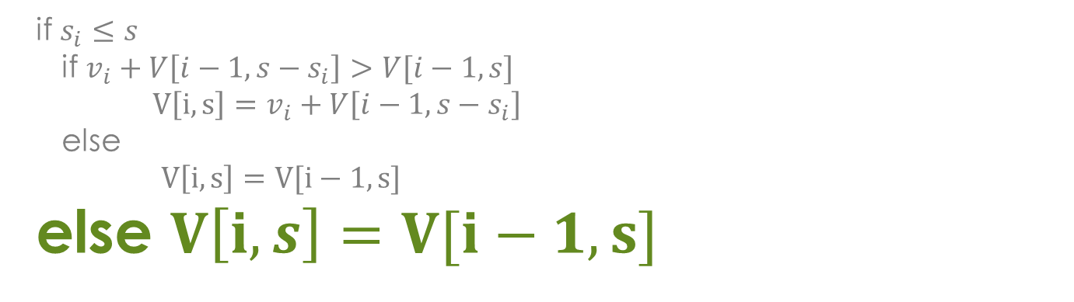
Example
i\s | 0 | 1 | 2 | 3 | 4 | 5
0 | 0 | 0 | 0 | 0 | 0 | 0
1 | 0 | 0 | 3 | 3 | 3 | 3
2 | 0 | 0
3 | 0
4 | 0
Notes:
i = 2
v_{i} = 4
s_{i} = 3
s = 1
s - s_{i} = -2

Slide 25
Example
i\s | 0 | 1 | 2 | 3 | 4 | 5
0 | 0 | 0 | 0 | 0 | 0 | 0
1 | 0 | 0 | 3 | 3 | 3 | 3
2 | 0 | 0 | 3
3 | 0
4 | 0
Notes:
i = 2
v_{i} = 4
s_{i} = 3
s = 2
s - s_{i} = -1

Slide 26
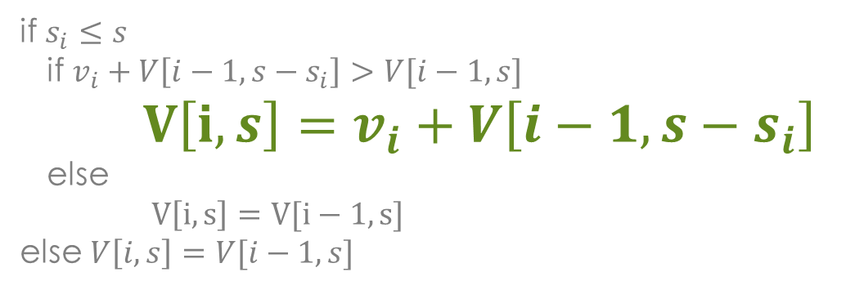
Example
i\s | 0 | 1 | 2 | 3 | 4 | 5
0 | 0 | 0 | 0 | 0 | 0 | 0
1 | 0 | 0 | 3 | 3 | 3 | 3
2 | 0 | 0 | 3 | 4
3 | 0
4 | 0
Notes:
i = 2
v_{i} = 4
s_{i} = 3
s = 3
s - s_{i} = 0

Slide 27
Example
i\s | 0 | 1 | 2 | 3 | 4 | 5
0 | 0 | 0 | 0 | 0 | 0 | 0
1 | 0 | 0 | 3 | 3 | 3 | 3
2 | 0 | 0 | 3 | 4 | 4
3 | 0
4 | 0
Notes:
i = 2
v_{i} = 4
s_{i} = 3
s = 4
s - s_{i} = 1

Slide 28
Example
i\s | 0 | 1 | 2 | 3 | 4 | 5
0 | 0 | 0 | 0 | 0 | 0 | 0
1 | 0 | 0 | 3 | 3 | 3 | 3
2 | 0 | 0 | 3 | 4 | 4 | 7
3 | 0
4 | 0
Notes:
i = 2
v_{i} = 4
s_{i} = 3
s = 5
s - s_{i} = 2

Slide 29
Example
i\s | 0 | 1 | 2 | 3 | 4 | 5
0 | 0 | 0 | 0 | 0 | 0 | 0
1 | 0 | 0 | 3 | 3 | 3 | 3
2 | 0 | 0 | 3 | 4 | 4 | 7
3 | 0 | 0 | 3 | 4
4 | 0
Notes:
i = 3
v_{i} = 5
s_{i} = 4
s = 1…3

Slide 30
Example
i\s | 0 | 1 | 2 | 3 | 4 | 5
0 | 0 | 0 | 0 | 0 | 0 | 0
1 | 0 | 0 | 3 | 3 | 3 | 3
2 | 0 | 0 | 3 | 4 | 4 | 7
3 | 0 | 0 | 3 | 4 | 5
4 | 0
Notes:
i = 3
v_{i} = 5
s_{i} = 4
s = 4
s - s_{i} = 0

Slide 31
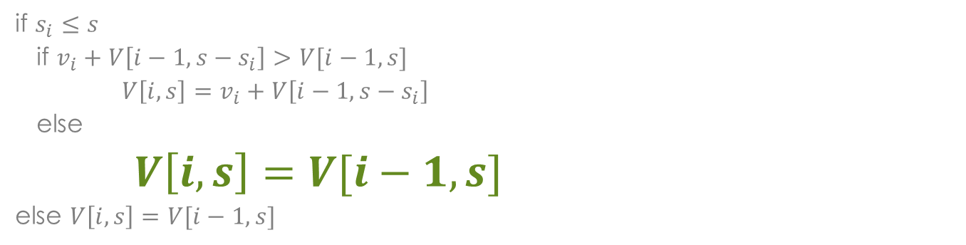
Example
i\s | 0 | 1 | 2 | 3 | 4 | 5
0 | 0 | 0 | 0 | 0 | 0 | 0
1 | 0 | 0 | 3 | 3 | 3 | 3
2 | 0 | 0 | 3 | 4 | 4 | 7
3 | 0 | 0 | 3 | 4 | 5 | 7
4 | 0
Notes:
i = 3
v_{i} = 5
s_{i} = 4
s = 5
s - s_{i} = 1

Slide 32
Example
i\s | 0 | 1 | 2 | 3 | 4 | 5
0 | 0 | 0 | 0 | 0 | 0 | 0
1 | 0 | 0 | 3 | 3 | 3 | 3
2 | 0 | 0 | 3 | 4 | 4 | 7
3 | 0 | 0 | 3 | 4 | 5 | 7
4 | 0 | 0 | 3 | 4 | 5
Notes:
i = 4
v_{i} = 6
s_{i} = 5
s = 1…4

Slide 33
Example
i\s | 0 | 1 | 2 | 3 | 4 | 5
0 | 0 | 0 | 0 | 0 | 0 | 0
1 | 0 | 0 | 3 | 3 | 3 | 3
2 | 0 | 0 | 3 | 4 | 4 | 7
3 | 0 | 0 | 3 | 4 | 5 | 7
4 | 0 | 0 | 3 | 4 | 5 | 7
Notes:
i = 4
v_{i} = 6
s_{i} = 5
s = 5
s - s_{i} = 0

Slide 34
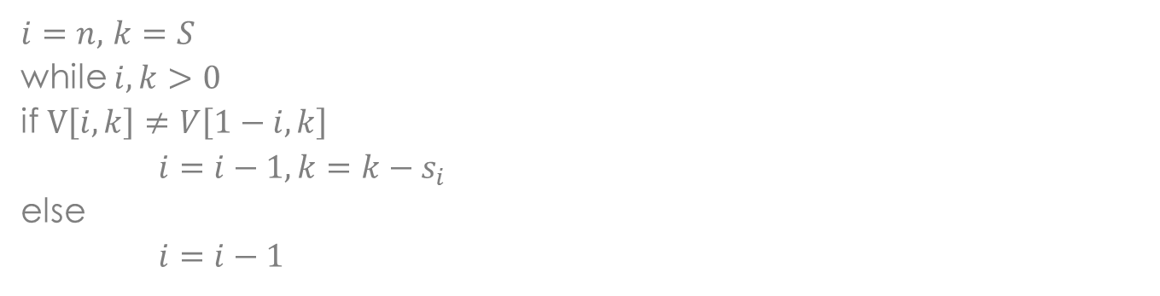
Example
i\s | 0 | 1 | 2 | 3 | 4 | 5
0 | 0 | 0 | 0 | 0 | 0 | 0
1 | 0 | 0 | 3 | 3 | 3 | 3
2 | 0 | 0 | 3 | 4 | 4 | 7
3 | 0 | 0 | 3 | 4 | 5 | 7
4 | 0 | 0 | 3 | 4 | 5 | 7

Slide 35
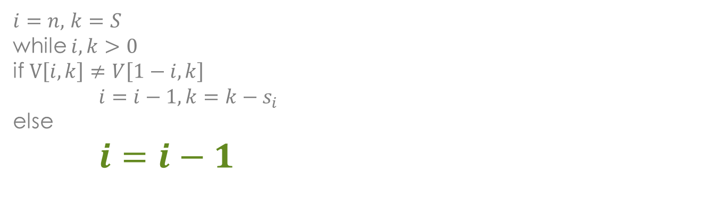
Example
i\s | 0 | 1 | 2 | 3 | 4 | 5
0 | 0 | 0 | 0 | 0 | 0 | 0
1 | 0 | 0 | 3 | 3 | 3 | 3
2 | 0 | 0 | 3 | 4 | 4 | 7
3 | 0 | 0 | 3 | 4 | 5 | 7
4 | 0 | 0 | 3 | 4 | 5 | 7

Slide 36
Example
i\s | 0 | 1 | 2 | 3 | 4 | 5
0 | 0 | 0 | 0 | 0 | 0 | 0
1 | 0 | 0 | 3 | 3 | 3 | 3
2 | 0 | 0 | 3 | 4 | 4 | 7
3 | 0 | 0 | 3 | 4 | 5 | 7
4 | 0 | 0 | 3 | 4 | 5 | 7

Slide 37
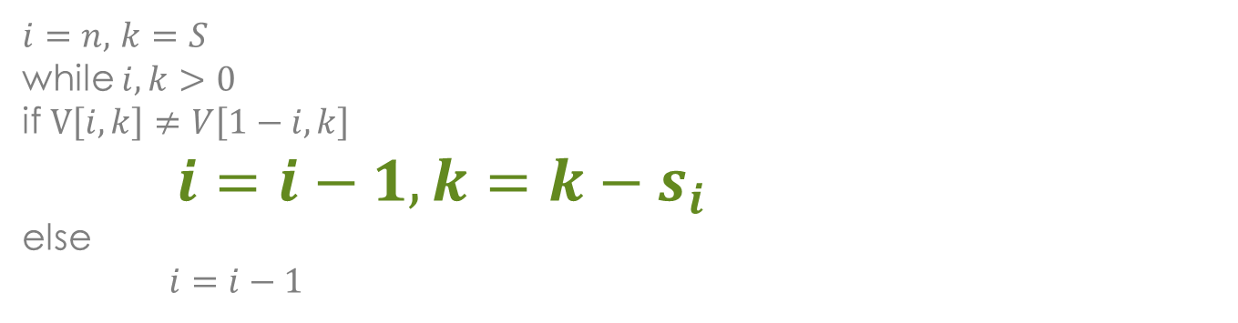
Example
i\s | 0 | 1 | 2 | 3 | 4 | 5
0 | 0 | 0 | 0 | 0 | 0 | 0
1 | 0 | 0 | 3 | 3 | 3 | 3
2 | 0 | 0 | 3 | 4 | 4 | 7
3 | 0 | 0 | 3 | 4 | 5 | 7
4 | 0 | 0 | 3 | 4 | 5 | 7

Slide 38
Example
i\s | 0 | 1 | 2 | 3 | 4 | 5
0 | 0 | 0 | 0 | 0 | 0 | 0
1 | 0 | 0 | 3 | 3 | 3 | 3
2 | 0 | 0 | 3 | 4 | 4 | 7
3 | 0 | 0 | 3 | 4 | 5 | 7
4 | 0 | 0 | 3 | 4 | 5 | 7

Slide 39
Example
i\s | 0 | 1 | 2 | 3 | 4 | 5
0 | 0 | 0 | 0 | 0 | 0 | 0
1 | 0 | 0 | 3 | 3 | 3 | 3
2 | 0 | 0 | 3 | 4 | 4 | 7
3 | 0 | 0 | 3 | 4 | 5 | 7
4 | 0 | 0 | 3 | 4 | 5 | 7

Slide 40
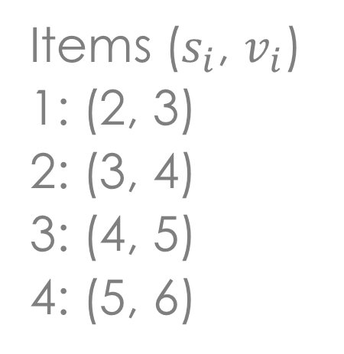
Example
The optimal knapsack should contain {1,2} = 7
i\s | 0 | 1 | 2 | 3 | 4 | 5
0 | 0 | 0 | 0 | 0 | 0 | 0
1 | 0 | 0 | 3 | 3 | 3 | 3
2 | 0 | 0 | 3 | 4 | 4 | 7
3 | 0 | 0 | 3 | 4 | 5 | 7
4 | 0 | 0 | 3 | 4 | 5 | 7

